Slide 1
Living Lego
by Terry Meyer

Slide 2

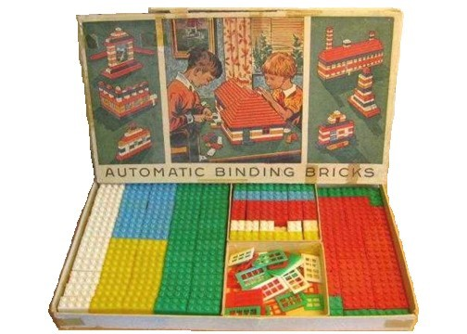
produced the first set in 1949 , "Automatic Binding Bricks"
Simple
Primary Colors
142 Pieces
Creativity
Experimentation

Slide 3
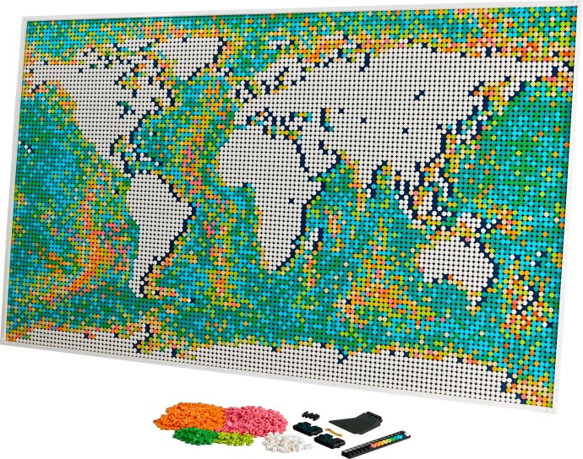
produced the biggest set in 2021 , "World Map"
Complex
Boring Colors
11695 Pieces
Time Filler
Follow the Directions

Slide 4
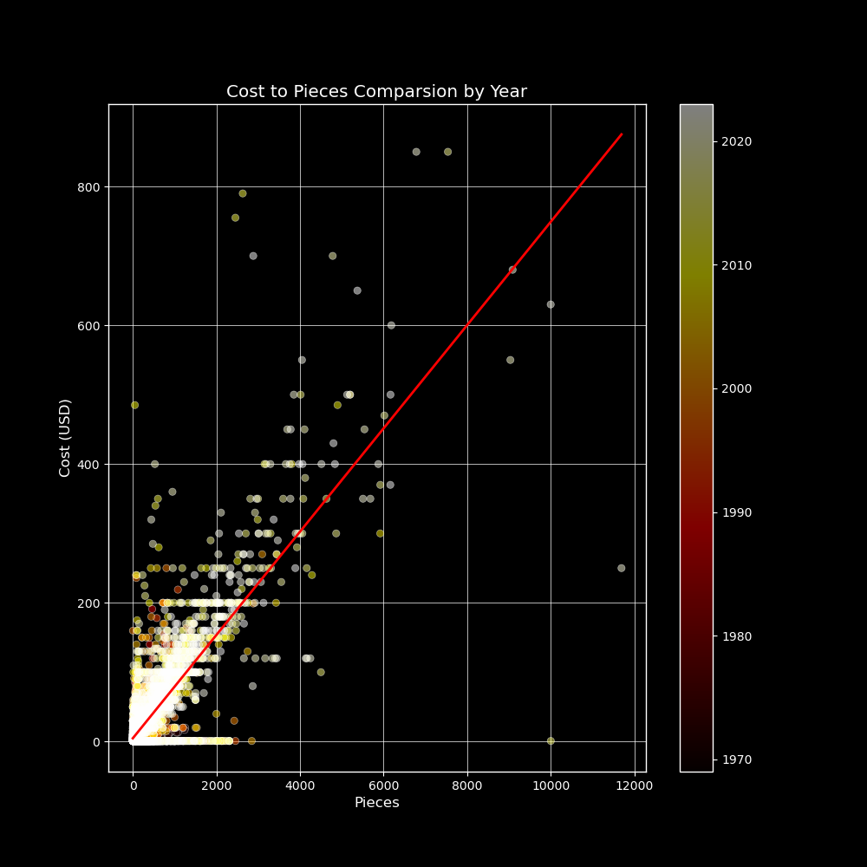
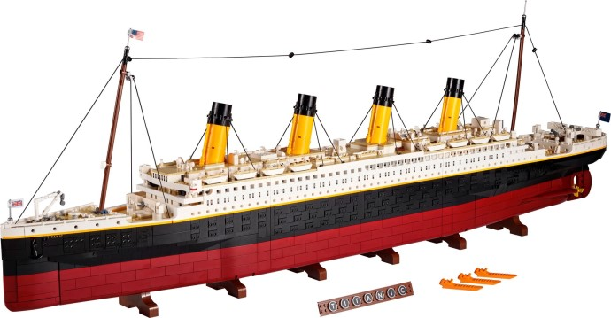
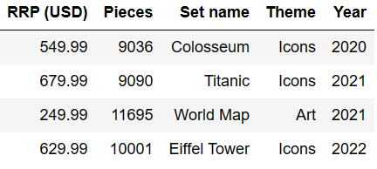
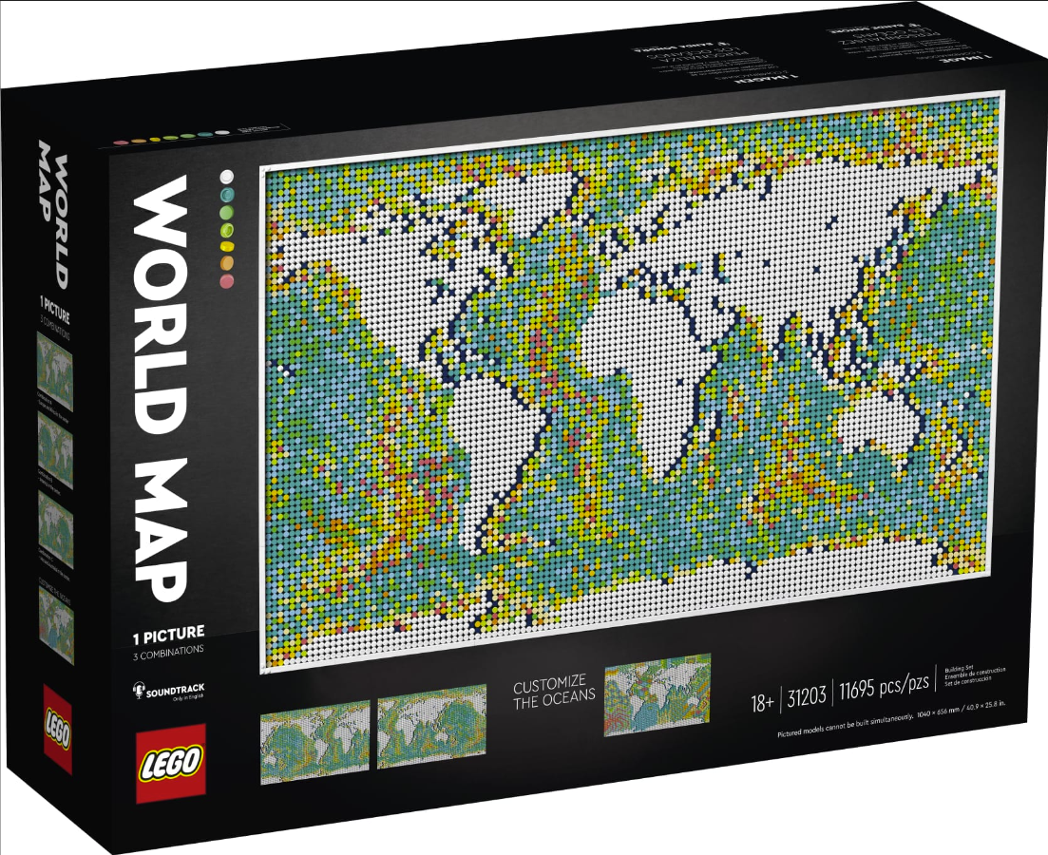
CORRELATION: Cost & Pieces
Piece Count correlates to Cost
Most sets are less that $200 and less than 2000 pieces
Since 2000, another group of sets appears with 2000-6000 pieces
Titanic (still expensive and significant); sorry World Map
Years

Slide 5
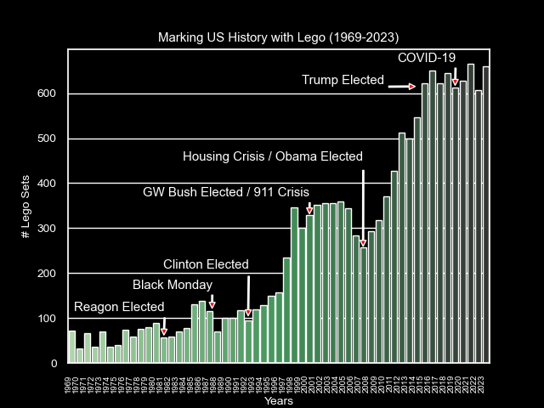
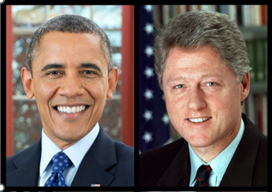
Important HISTORY Features
COVID - 19
Lego Sets production appears to track the US economy
Lego prefers Democrats?

Slide 6
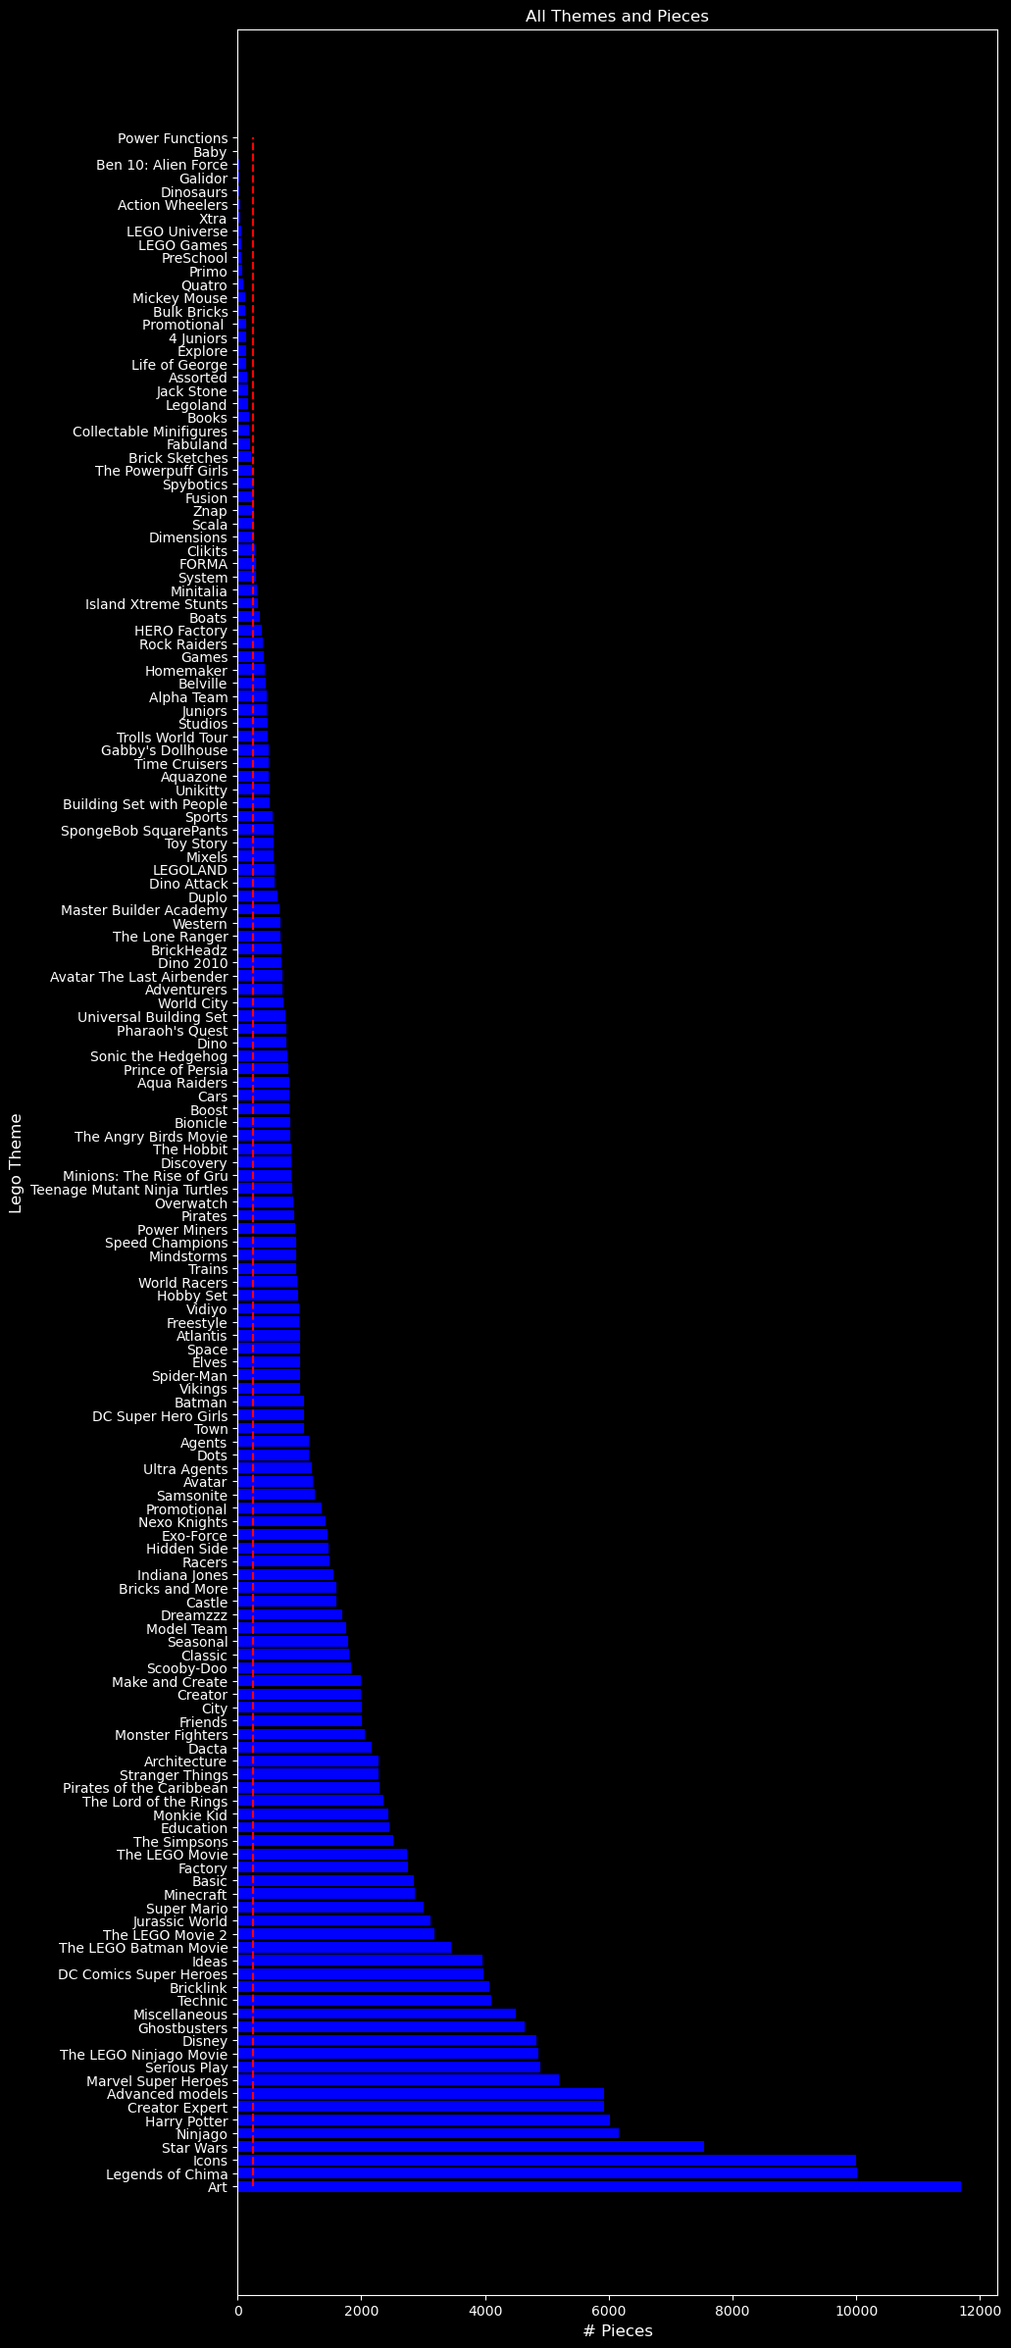
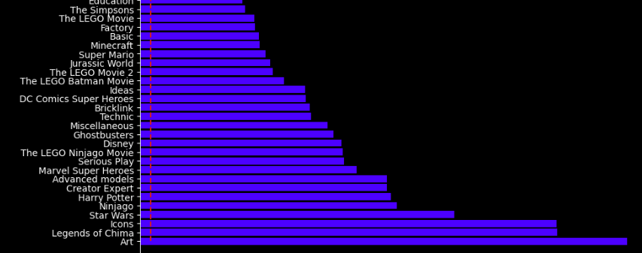
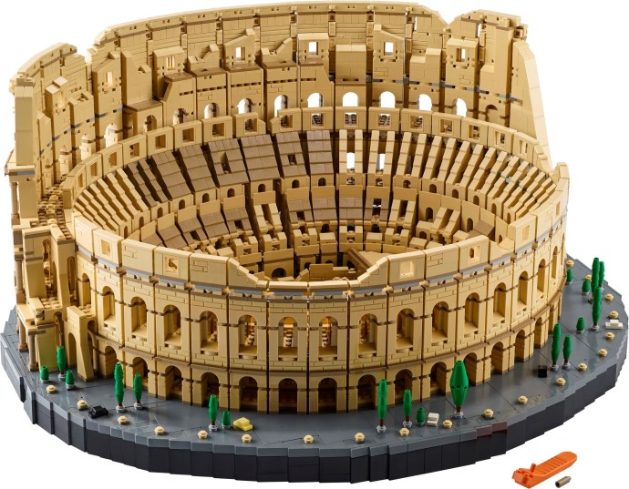
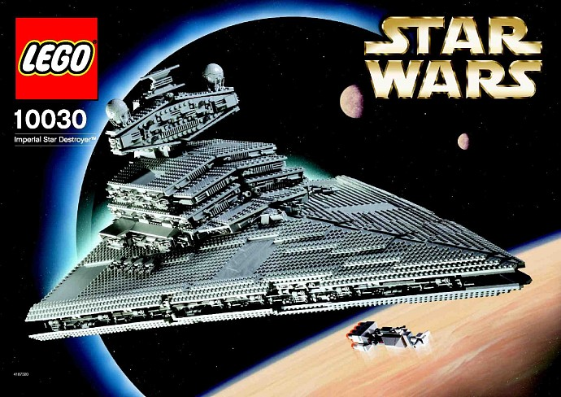
THEMES that build the foundation of the Lego pieces tower
Mean Piece Count

